Slide 1
Unit-1
Deep Learning

Slide 2
Topics covered in Unit-1:-
ANN (Introduction)
Perceptron (Sigmoid)
Back Propagation
Batch Normalization
Activation function (Sigmoid, ReLU, Hyperbolics FNS, Softmax)
Perceptron VS MLP
FFN
Gradient Decent
Stochastic Gradient Decent

Slide 3
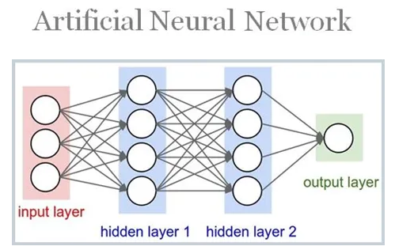
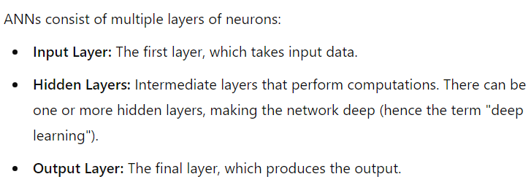

Slide 4
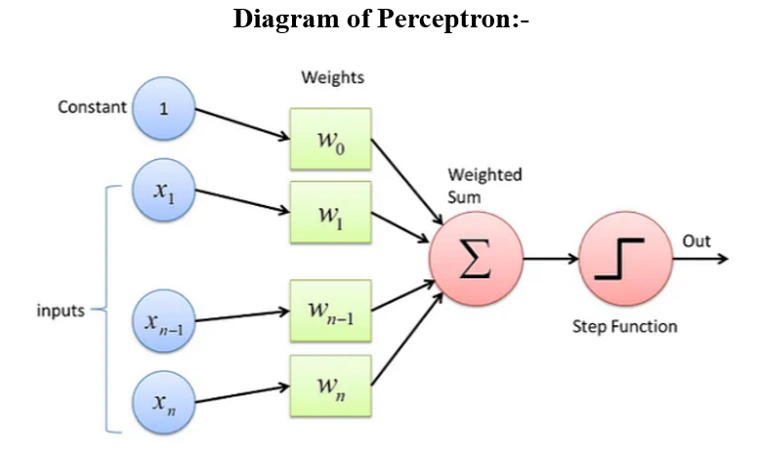
Perceptron
It's important to note that while all perceptrons are neurons, not all neurons are perceptrons. In simple terms, a perceptron is a type of neuron, but there are other types as well, which work differently. The perceptron equation (y = f(wx + b)) is just one way to represent a neuron, but neurons come in different forms and have various functions.
While a perceptron primarily produces binary outputs (0 or 1), when the output is extended to probabilities, typically using a sigmoid activation function, it is often called a sigmoid neuron or sigmoid perceptron. This means that the perceptron and sigmoid neuron share a similar structure, but the key difference is in how they handle the output.
Perceptron: Produces a binary output (0 or 1) based on a threshold.
Sigmoid Neuron (or Sigmoid Perceptron): Produces an output in the range of 0 to 1, representing a probability, and uses the sigmoid function.

Slide 5
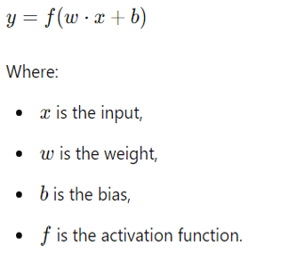
Sigmoid Perceptron :-

Slide 6
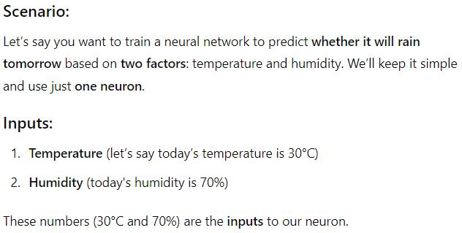

Slide 7
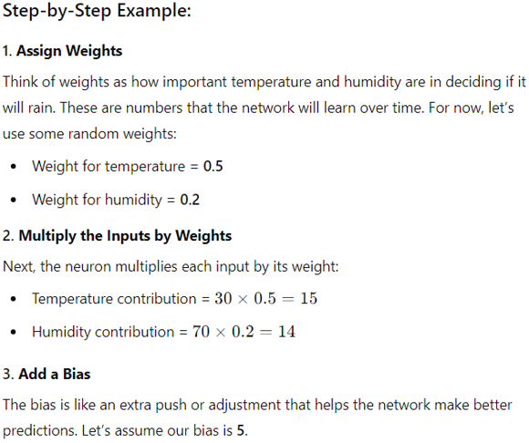

Slide 8
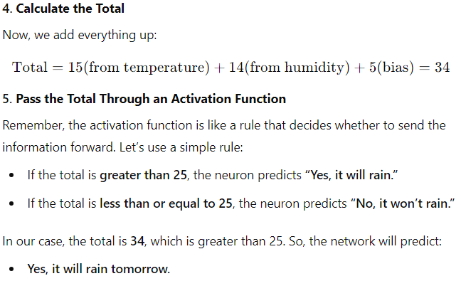

Slide 9
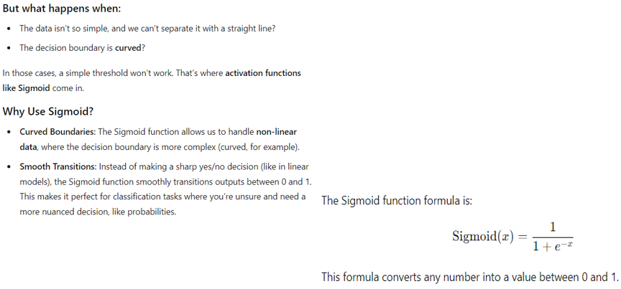

Slide 10
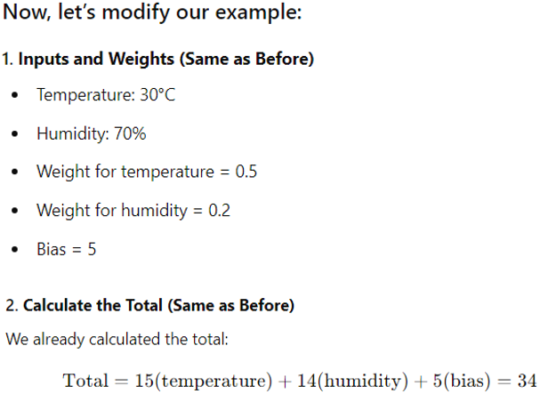

Slide 11
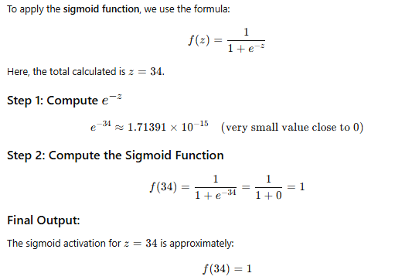

Slide 12
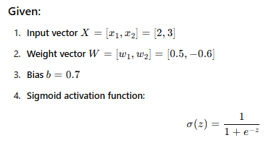
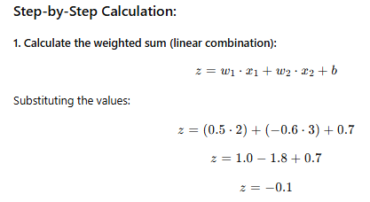

Slide 13
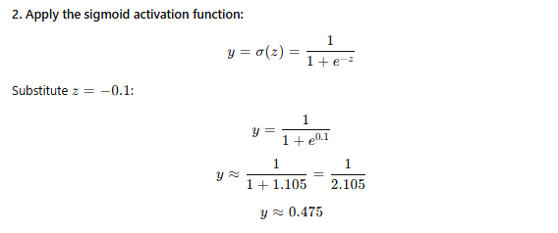


Slide 14
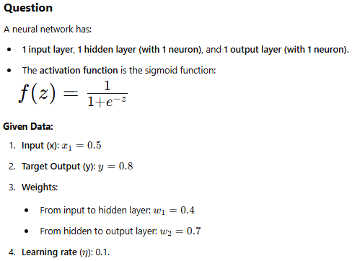
Back Propagation

Slide 15
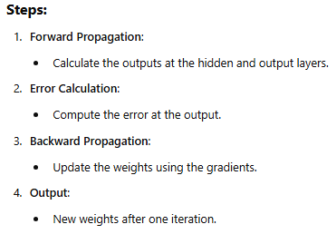

Slide 16
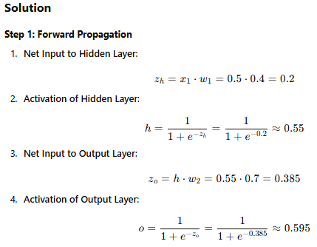

Slide 17

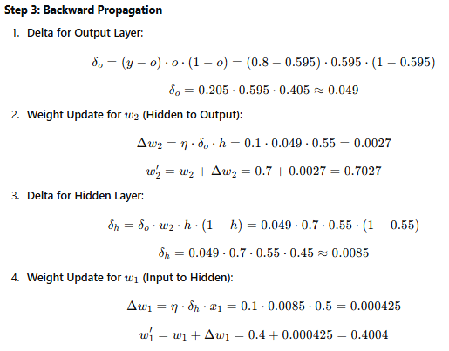

Slide 18
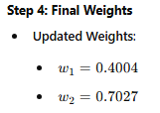


Slide 19
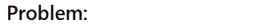


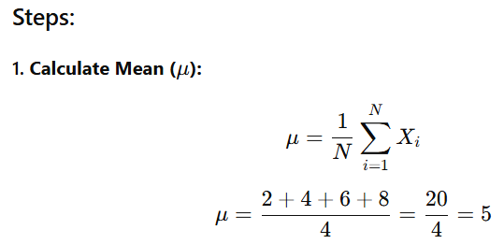
Batch Normalization

Slide 20
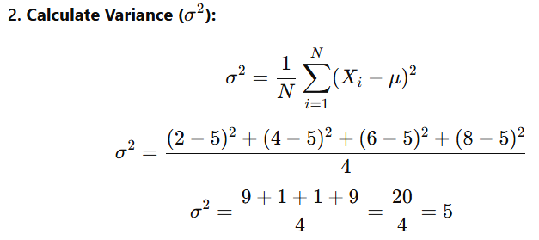
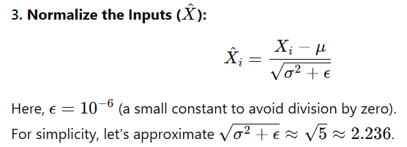
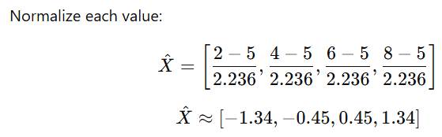

Slide 21
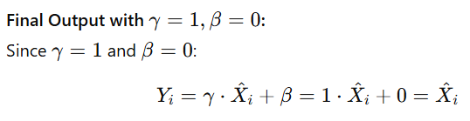
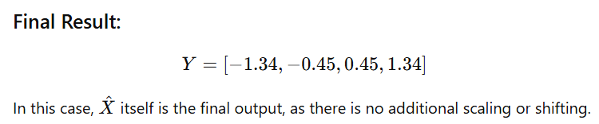

Slide 22
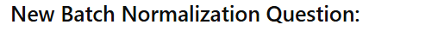
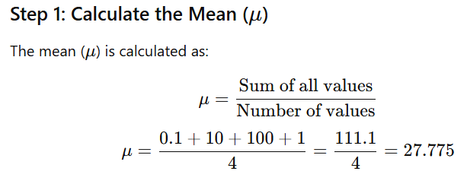
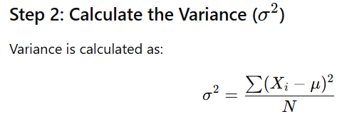

Slide 23
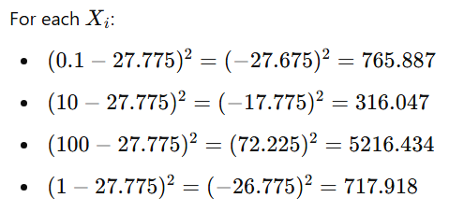
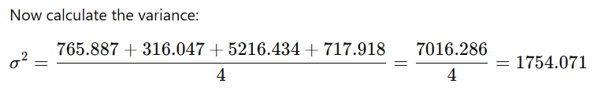
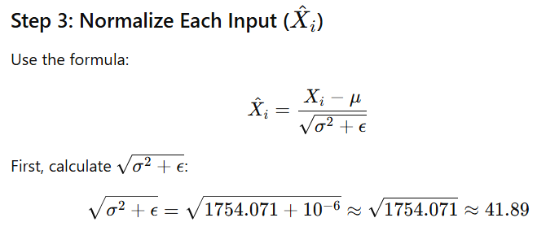

Slide 24
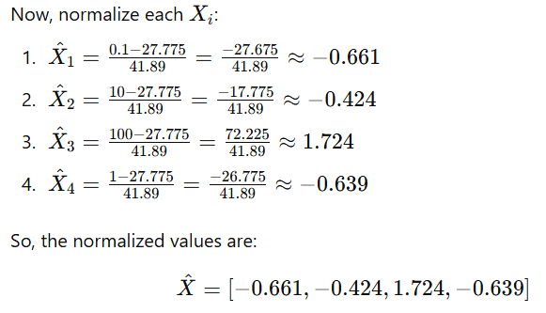
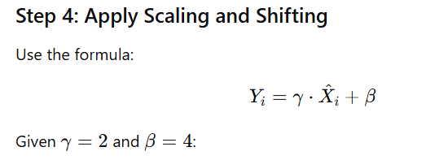

Slide 25
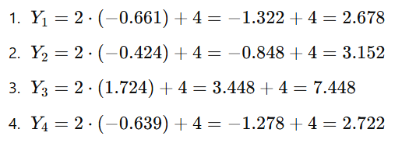
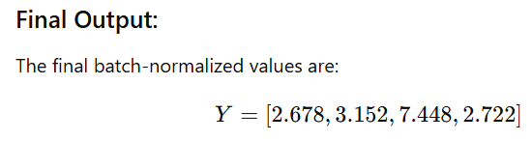

Slide 26
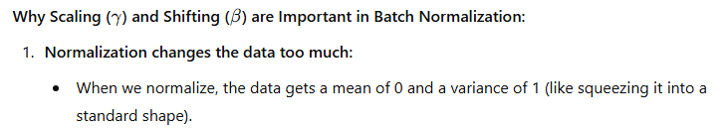
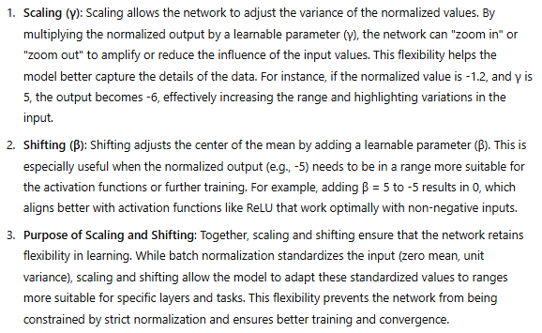

Slide 27
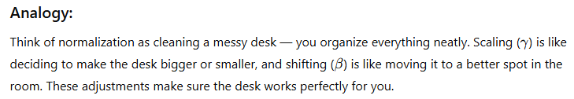

Slide 28
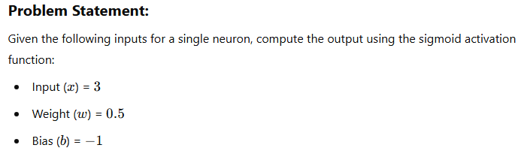
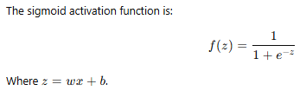
Activation function (Sigmoid)

Slide 29
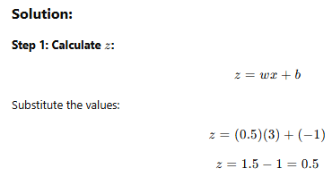
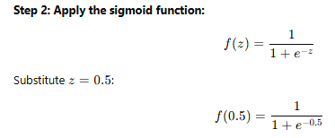

Slide 30
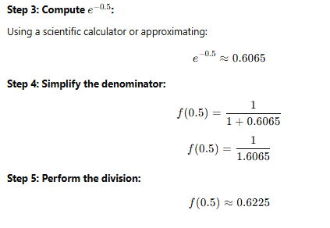


Slide 31
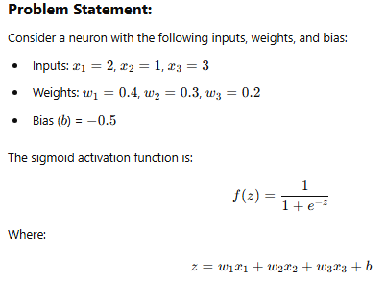

Slide 32
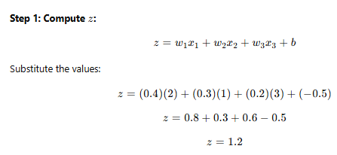
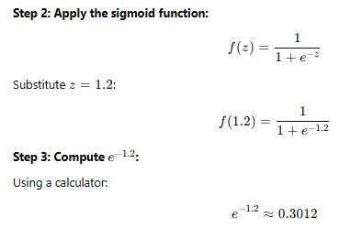

Slide 33
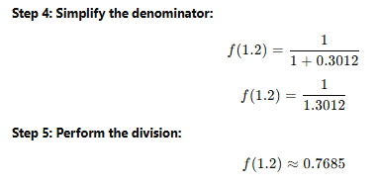


Slide 34
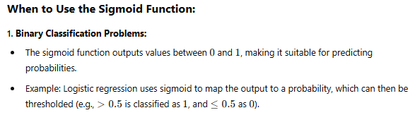
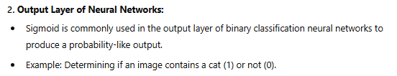

Slide 35
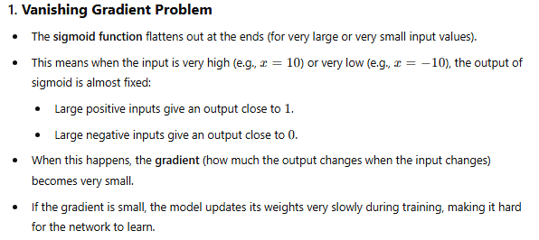


Slide 36


Activation function (Rectified Linear Unit)

Slide 37




Slide 38




Slide 39


Activation function (Hyperbolic Functions (FNs))

Slide 40



Activation function (Tanh)

Slide 41



Slide 42


Slide 43



Slide 44



Slide 45



Slide 46


Slide 47




Activation function (Softmax)

Slide 48


Slide 49



Slide 50


Slide 51



Slide 52


Slide 53


Sigmoid v/s ReLU v/s Tanh v/s Softmax

Slide 54



Slide 55


Numericals of Softmax, Sigmoid, ReLU, Tanh

Slide 56



Slide 57


Slide 58




Slide 59

Sigmoid-

Slide 60



Slide 61




ReLU-

Slide 62

Tanh-

Slide 63



Slide 64



Slide 65


Slide 66



Slide 67



Slide 68

Perceptron VS MLP

Slide 69


Slide 70


Slide 71

FFN

Slide 72


Slide 73

FFN vs Back Propagation:

Slide 74

Gradient Decent

Slide 75



Slide 76



Slide 77

Gradient Decent vs Stochastic Gradient Descent

Slide 78


